Slide 1
Lecture one

Slide 2
Cohesion
Next we consider the relations between sentences. The most common forms these take are connectives denoting addition, contradiction, contrast, result, etc. These connectives are tricky when they are polysemous, since they may have meanings contradicting each other,
e.g.:
('in the meantime', 'nevertheless), ('however1, 'on the other hand1), ('moreover, 'on the other hand), ('besides', 'however'), ('always', 'nevertheless'), ('therefore', 'consequently', 'also'), ('whilst', 'although', etc.); ('for what reason*, 'for what purpose, 'on what ground), 'so that, ('from then on', 'that being the case', 'consequently')

Slide 3
REFERENTIAL SYNONYMS
Sentences cohere through the use of referential synonyms, which may be lexical, pronominal or general.
SL pronouns and deictics including le premier^ le second (cf. 'the former', 'the latter') are often replaced by English nouns, since the range of some English pronouns, ('it', 'they', 'this one') is much wider than in languages with nouns split between two or three genders. An example of mistranslation of pronouns is in the Authorised Version, Isaiah 37,36: 'Then the angel of the Lord went forth and smote in the camp of the Assyrians a hundred and four score and five thousand. And when they arose early in the morning, behold, they were all dead.' Today's English Version: 'An Angel of the Lord went to the Assyrian camp and killed 185,000 soldiers- At dawn the next day, there they lay, all dead.'

Slide 4
Lastly, words at all degrees of generality can be used to connect sentences, from general words ('thing', 'object', 'case', 'affair' through 'hypernyms' (super-ordinate nouns) ('horse') and 'hyponyms to proper name, nickname, familiar alternative, pronoun.
In many cases, all three types of referential synonym are used to avoid repetition rather than to supply new information (which, in any event, is incidental, thematic, and not pan of the sentence's message). Whilst the translator must reproduce the new information, he should not be afraid of repetition, in particular of repeating the most specific termor the proper name to avoid any ambiguity.
ENUMERATORS
Enumerators (Lenumeralive conjuncts') also act as connectors between sentences.
OTHER CONNECTIVES
Linguistic synonyms are also used as a cohesive device to avoid repetition, particularly in a reinforcing sentence.

Slide 5
Newmark: semantic and communicative translation
Peter Newmark (1916–2011)’s Approaches to Translation (1981) and A Textbook of Translation (1988) have been widely used on translator training courses and combine a wealth of practical examples of linguistic theories of meaning with prac- tical applications for translation. Yet Newmark departs from Nida’s receptor- oriented line. He feels that the success of equivalent effect is ‘illusory’ and that ‘the conflict of loyalties, the gap between emphasis on source and target language, will always remain as the overriding problem in translation theory and practice’ (Newmark 1981: 38). Newmark suggests narrowing the gap by replacing the old terms with those of ‘semantic’ and ‘communicative’ translation:
Communicative translation attempts to produce on its readers an effect as close as possible to that obtained on the readers of the original. Semantic translation attempts to render, as closely as the semantic and syntactic structures of the second language allow, the exact contextual meaning of the original.

Slide 6
This description of communicative translation resembles Nida’s dynamic equivalence in the effect it is trying to create on the TT reader, while semantic translation has similarities to Nida’s formal equivalence. However, Newmark distances himself from the full principle of equivalent effect, since that effect ‘is inoperant if the text is out of TL space and time’ (1981: 69). An example would be a modern British English translation of Homer. No modern translator, irrespective of the TL, can possibly hope or expect to produce the same effect on the reader of the written TT as the oral ST had on its listeners in ancient Greece. Newmark (ibid.: 51) also raises further questions concerning the readers to whom Nida directs his dynamic equivalence, asking if they are ‘to be handed everything on a plate’, with everything explained for them.
Other differences are revealed by Newmark’s definitions of his own terms (ibid.: 39–69), summarized in Table 1. Newmark (ibid.: 63) indicates that semantic translation differs from literal translation in that it ‘respects context’, interprets and even explains (metaphors, for instance). On the other hand, literal translation means word-for-word in its extreme version and, even in its weaker form, sticks very closely to ST lexis and syntax

Slide 7
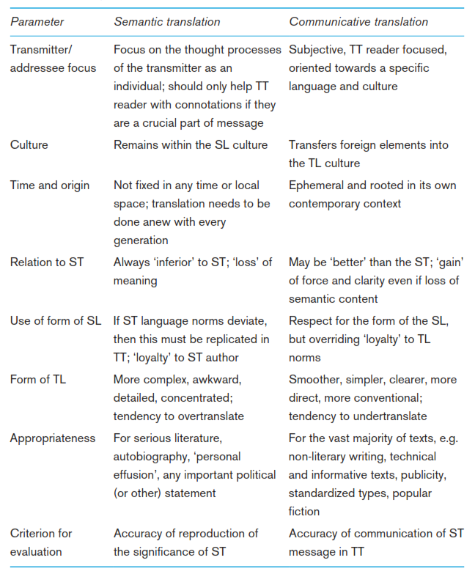
Table 1: Comparison of Newmark’s semantic and communicative translation

Slide 8
Importantly, as long as equivalent effect is achieved, Newmark holds literal translation to be the best approach:
In communicative as in semantic translation, provided that equivalent effect is secured, the literal word-for-word translation is not only the best, it is the only valid method of translation.
This assertion can be related to what other theorists (e.g. Levý 1967/2000, Toury 1995/2012) have said about the translator’s work. Namely, that the constraints of time and working conditions often mean that the translator has to maximize the efficiency of the cognitive processes by concentrating energy on especially difficult problems, by devoting less effort to those parts of the text where a reasonable translation is produced by the ‘literal’ procedure. However, if there is a conflict between the two forms of translation (if semantic translation would result in an ‘abnormal’ TT or would not secure equivalent effect in the TL) then communicative translation should be preferred.

